Slide 1
University Procurement
August 2020

Slide 2
Procurement
in the
University of Strathclyde
Status | Final
Owner | University Procurement
Source location | Procurement website
Endorsed | Head of Procurement
Publication | August 2020
Next Review Date | July 2021
Update | August 2020
Notes:
Thank you for accessing the University’s Procurement Awareness training. This training is intended for all staff, and will be useful for all regardless of how often your role involves purchasing for the University.
This training has been issued by the central Procurement Team, who are here to help with any purchasing or procurement queries, regardless of the type of requirement or the value involved. We hope you find this training both relevant and useful.

Slide 3
What We Will Cover
Public Procurement Legislation
University Value Thresholds
Types of Contracts and Terminology
The Role of Procurement & the Stakeholder
The Role of Specifications
Tendering Processes
Single Source Justification – awarding without competition
Contract Notices
What does this mean in practice
Award Notices and Notification
Community Benefits
FMS Policies & Procedures
          New Supplier Requests
          NO PO No Payment
          Request for Payment
Notes:
We will be covering a vast area, and the purpose of this training is intended to give all staff an overview of the University’s Procurement policies and processes, which are largely underpinned by Scottish and EU legislation. This slide provides an outline of what we will be covering in this training.

Slide 4


Legislation and Guidance
Directive 2014/24/EU
The Public Contracts (Scotland) Regulations 2015
The Public Contracts (Scotland) Amendment Regulations 2016
The Procurement Reform (Scotland) Act 2014
Notes:
Whilst the University is not necessarily a public sector organisation the funding received comes from Public sector sources e.g. the Scottish funding council and much of the grant funding is from government sources.
Therefore the University is subject to the rules that govern Public Sector Procurement. These include the likes of freedom of information requests and procurement legislation.
These rules originated from a Directive of the European Parliament a number of years ago, the most recent directive is Directive 2014/24/EU.
Following Europe's lead the UK government ratified these into national law. And in Scotland we decided to have a kilted version.
The most recent update follows the 2014 Directive in the form of The Public Contracts (Scotland) Regulations 2015 as amended in 2016.
Guidance also comes in the form of the PRSA 2014 which introduces a sustainable procurement duty amongst other duties.
Procurement Strategies and Annual Reports (s. 20)
Sustainable Procurement Duty (s. 10)
Community Benefit Requirements in Procurement (s. 26)
Selection of Tenderers and Award of Contracts (s. 29)
Procurement for Health or Social Care Services (s. 13)
Legal context
Union law
3 Under the second and third subparagraphs of Article 1(9) of Directive 2004/18:
‘A “body governed by public law” means any body:
(a) established for the specific purpose of meeting needs in the general interest, not having an industrial or commercial character, and
(b) having legal personality, and
(c) financed, for the most part, by the State, regional or local authorities, or other bodies governed by public law; or subject to management supervision by those bodies; or having an administrative, managerial or supervisory board, more than half of whose members are appointed by the State, regional or local authorities, or by other bodies governed by public law.
Non-exhaustive lists of bodies and categories of bodies governed by public law which fulfil the criteria referred to in (a), (b) and (c) of the second subparagraph are set out in Annex III.’

Slide 5
EU Procurement Principles
Free Movement
Proportionality
Transparency
Mutual Recognition
Competition
Non-Discrimination
Value for Money
(VfM)
Equal Treatment
Notes:
EU Procurement Principles
Our procurement duties all stem from basic EU treaty principles. Briefly, we can review these motivations behind our EU legal duties (that aren’t changing):
First, the free movement of goods and services is enshrined in the EU treaties to promote a “Single Market” between all member states in the European Union.
Second, Preference for competition is enshrined in law-we have the requirement to procure through competition in most cases—the rationale being that competition promotes the best outcomes, healthy markets, and low corruption.
And lastly, we have the principle of Value for Money or VFM, where a goal of procurement law is to achieve the best value in purchasing, ensuring efficient use of public money—not always the best price.
(Click) These policy goals are the basis of 5 procurement principles that directly underpin most of our legal duties:
equal treatment and non-discrimination of economic actors—the need to show no favouritism in order to avoid corruption,
mutual recognition of economic actors between member states—we recognise qualifications and economic operators from other member states and they recognise ours,
transparency—for both the public and to the market, so people know about how we spend public money, and
proportionality—stating that our obligation as well as the requirements ask of our suppliers is proportionate to the level we are spending—we ask for more when more is at stake.

Slide 6
Scottish Procurement Context
Priorities:
  Embrace EU process and wider policy role
  Sustainability
Procurement Reform (Scotland) Act 2014:
  Additional to EU Directive for lower threshold
  Sustainable Procurement Duty now legal requirement
Public Contracts (Scotland) Regulation 2015 replaced 2012 version
Notes:
Scottish Government has two clear trajectories with EU procurement law: First is a general Embrace of EU procurement process, and particularly adopting a wider policy role of public procurement. By that we mean that the government has embraced the notion that public procurement plays an important role in areas beyond a strict commercial function.
The second is the emphasis on sustainability in procurement. The government has embedded social, economic, and environmental sustainable outcomes as a core purpose of government policy, and furthermore has cited procurement rules as key means to reach these goals. As you’ll be aware, the Scottish Model of Procurement seeks to embed consideration of sustainability into every aspect of procurement.
How has that informed new duties, and how are duties different in Scotland? Well in addition to transposition of EU Procurement Directive into the 2015 Public Contracts Regulations that we are looking at today, the SG has followed a long Procurement Reform Program to develop a complementary law, the Procurement Reform (Scotland) Act 2014, that sits beside the act, regulating a lower threshold.
Codified responsibilities re Sustainability along with codified National Outcomes + SG model of procurement, embedding sustainability

Slide 7



Summary
All governed by EU Principles
Goods /Services
<£50k
Works
<£2m
Goods /Services
£50k to £189K
Works
£2m to £4.7m
Goods /Services
>£189k
Works
>£4.7m
Local Governance
Procurement Reform (Scotland) Act 2014
Procurement (Scotland) Regulations 2016
Public Contracts
(Scotland) Regulations 2015
Local procurement rules
E.g. 3 quotes
E.g. call off from framework
Regulated procurement rules
Additional Rules
Lower Level of Spend
EU Regulated procurement
Transpose EU Rules
Higher Level of Spend
Notes:
This slide provides an overview of the governance structure for spending University funds.
Please also note, The legislation prohibits:
Sub dividing a contract with the effect of excluding the contract from the Regulations (unless justified by objective reasons)
Choosing a method to be used to calculate the estimated value with the intention of excluding the procurement from the Regulations.
All external spend above £3000 will fall within this structure. As you can see on the far left, any spend below £50k for goods and services and £2m for works is subject to internal University policy. The standard approach is for departments to obtain three quotations for any requirement between £3000 and £25k. These quotes should be held electronically and attached to any subsequent new supplier request or requisition.
If a requirement is between £25k - £50k, internal University policy advises that a process should be undertaken through a Scottish Govt portal, in conjunction with Procurement.
As you’ll see moving along the structure, the Procurement Reform Scotland Act 2014 governs all spend between £50k - £189k, and the Public Contracts (Scotland) Regulations 2015, which transpose EU Directive into Scots Law govern spend above £189k. Please note therefore that any spend for Goods & Services above £50k is classes as a ‘regulated procurement’. Our obligations in relation to regulated procurement activity is discussed further in the next slide.

Slide 8
Non Compliance Procurement Risks
Litigation, Damages and Fines
Claw back of funding
Potential Criminal Charges
Costly Delays
Reputational Damage
Loss of Value, Lost Opportunities, and Resource Impacts
Notes:
Part of procurement’s role here at the University is to assess and inform staff of the risks of non-compliance.
Ultimately a Court can set aside the award of any contract and in doing so impose:
Litigation, Damages and Fines – These as you can imagine can be very costly for the organisation.
Claw back of funding- This is in relation to Grant funding- There have been instances across the sector where funding auditors have claimed returns of a portion of the funding due to non compliance with procurement legislation and ultimately their grant conditions.
Potential Criminal Charges- There have been reported instances of corruption across the public sector. At the University we ask that those involved in the tendering procedures sign conflict of interest and confidentiality statements. And the FMS spend data is analysed to understand spending patterns.
Costly Delays- Where the process is above the EU threshold then the contract can be suspended.
Reputational Damage- a high proportion of the University spend comes through public sector funding and if we are not ensuring best value and good practice is followed the University’s reputation could be at risk.
Loss of Value, Lost Opportunities, and Resource Impacts
All of the above creates a negative impact on the University. Auditing and legal investigations can be very resource intensive.

Slide 9
The Value of your Requirement
Important information is contained within Regulation 6 of the Public Contracts (Scotland) Regulations 2015 for estimating budgets, and completing new supplier request forms.
The full regulation applies however, the points on the next slide are particularly relevant for the University.
Notes:
The legislation gives clear guidance on how the estimated value of a requirement should be calculated. This guidance requires that the University takes into account all costs associated with a requirement, which is considered as the total aggregate value of the amount payable under the contract. This may include, but not be limited to:
cost of purchase
Delivery
Installation
Support and maintenance (where purchased through the supplier)
The accuracy of calculating the aggregate spend is important for both informing the correct route to market being used, and also for adding new suppliers onto FMS. If a supplier is not originally added for the correct spend, they will be parked on the system before the full contract has been fulfilled. Adding a supplier based on an incorrect budget would potentially increase resource time in ensuring compliance again once the spend goes above the original value given.

Slide 10
Some relevant points from Reg 6
Methods for calculating the estimated value of a contract - Regulation 6.
(1) A contracting authority must calculate the estimated value of a contract by reference to the total amount payable under it (regardless of the form of such payment), not including value added tax.
(2) The total amount payable includes the amount payable as a result of the exercise of any form of option and any renewal of the contract as explicitly set out in the procurement documents.
(5) A contracting authority must not choose a method to be used to calculate the estimated value of a contract with the intention of excluding the contract from the application of these Regulations.
(6) A contracting authority must not sub-divide a contract with the effect of excluding the contract from the application of these Regulations unless such sub-division is justified by objective reasons.
(10) In the case of a public works contract the estimated value shall include the total estimated value of any supplies and services that are necessary for executing the works and are to be provided by the contracting authority to the contractor.
(16) In the case of a public service contract which does not indicate a total price, the estimated value must be calculated by reference to—
(a)in the case of a contract for a fixed term of less than or equal to 48 months, the total value of the contract for its full term; and
(b)in the case of a contract for a fixed term of more than 48 months or a contract without a fixed term, the monthly value multiplied by 48.

Slide 11
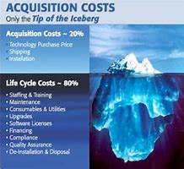
Estimating The value of a requirement
Value is considered as the total aggregate value of the amount payable under the contract.
  Things to consider:
    cost of purchase
    delivery
    installation
    Support and maintenance (where purchased through the supplier)
Important for estimating budgets, and completing new supplier request form
Notes:
The total cost to purchase with a supplier must be considered not individual items or disaggregation of spend.

Slide 12
Frameworks
Staff should check the Framework Register first
Benefits of using a Framework:
Terms & conditions have been agreed
Framework suppliers have been pre-qualified as having the correct capabilities and capacity
Notes:
If you have a requirement for over £3,000, the Procurement team advise that you consult the Frameworks Register in the first instance. As will be discussed later, a ‘Framework’ is an agreement with one or more suppliers for a specific requirement, in which ‘call off’ contracts or orders can be placed through. The Framework itself is not a contract, and the Frameworks Register, which details all the available Frameworks, is contained in the Procurement webpage.
The benefits of using Frameworks include pre-agreement of the terms and conditions governing a call off order or contract, and pre-qualification of the suppliers listed that they have the correct capabilities and capacities for our requirement.

Slide 13
Goods and Services Process
Procurement Value (Ex VAT) Process
Less than £3,000 No quotes required.
£3,001 to £24,999 Minimum of 3 recorded quotations
£25,000 to £50,000 Quotation in consultation with UP via Public Contracts Scotland
Over £50,000 Contact UP will tender
Above £189,330 Tender following EU regulations
Notes:
This slide details the value thresholds that apply for Goods & Services. Please remember that any spend above £25k should be communicated to Procurement, who will conduct a tendering exercise with you in order to remain compliant with University governance.
As discussed, any spend for goods & services above £50k, is classed as a ‘regulated procurement’, and Regulation is involved in how these funds are spent.

Slide 14
Works Process
Procurement Value (Ex VAT) Process
Not exceeding £99,999 Minimum of 3 written quotations
Above £100,000 Tender in consultation with UP
Above £2,000.000 Regulated procurement process which must be advertised on the tendering portal (PCS)
Above £4,733,252 Tender following EU regulations
Notes:
Similar thresholds apply for any works requirements, however you will note that the thresholds are a lot higher. In line with the previous guidance, the Procurement team should be contacted for any works requirements above £100k, and a requirement above £2m becomes a ‘regulated procurement’.
In both slides regarding the thresholds for goods, services, and works, the EU threshold values have been updated to reflect the current set values for EU tenders – which were adjusted and released in January 2018.

Slide 15
Who Tenders Contracts?
Crown Commercial Services – Class A National requirements.
Scottish Government - Class A - Country wide requirements.
Centres of expertise (APUC for HE/FE) – Class B – Country wide and Nationally with partners.
University Procurement - Class C contracts, call-offs from frameworks and quick quotes.
Notes:
University contracts, set up with suppliers, fall within three different classes:
Class A contracts refer to nationwide requirements, and are usually instated by the Scottish Government or CCS.
Crown Commercial Services – Class A National requirements.
High Value and identified as a requirement Nationally.
Scottish Government - Class A - Country wide requirements.
High value used across the Country. An example of a type of contract falling under Class A is the University’s water and water waste contract, which was set up by the Scottish Government.
Class B contracts will generally have been set up by centres of expertise (APUC for HE/FE) – Class B – Country wide and APUC will promote partner organisation frameworks
e.g. SUPC, NWUC - Nationally with partners.
Class C contracts are contracts placed locally by the Procurement team for requirements solely related to the University – such as a works contract for a refurbishment or build of a University building. These will either be set up via a call off from a Framework, or a one off bespoke contract set up by the University Procurement Team.

Slide 16
Terminology
Frameworks
A general term for agreement with suppliers that set out terms and conditions which specific (call-offs) can be made through.
Contracts
Established as a call off under a framework or a requirement tendered or established in line with legislation or guidance.
European Single Procurement Document (Scotland) ESPD(S)
This document replaces the previous Pre-Qualification Questionnaire (PQQ) and is mandatory for use in all European Procurements.
Notes:
Before we go any further, it is worth highlighting certain phrases commonly used when we speak about Procurement at the University, and exactly what these mean:
Frameworks
In most cases a framework agreement itself is not a contract, but the procurement exercise to establish a framework agreement is subject to the public procurement rules.
Contracts
A call off form a framework becomes a contract or a contract for defined ongoing supply can be created. Otherwise a contract is formed by approaching the market for goods, works or services. This may be dome through any of the approaches laid out. Open, quick quote or a negotiated (SSJ).
ESPD(S)
This document is standard across Scotland. It requests information about the bidder, deals with mandatory exclusions such as grounds relating to criminal convictions, discretionary exclusions such as bankruptcy and selection critiera, looking at bidders financial status, technical and professional ability amongst others.

Slide 17
The process
What does Procurement Do?
Consider the sourcing strategy and the commercial element
Support with advice on the correct procurement route
Develop documents with support on specification.
Support contract/supplier management
Consider compliance with Procurement Legislation and mitigate risk for the University.
Notes:
The Procurement team will in conjunction with the department, faculty or service create a strategy in relation to your requirement. This strategy is to ensure full consideration is given at the outset to all relevant factors necessary for a successful contractual outcome.
This will also include an options appraisal of the appropriate procurement route for the particular requirement.
The team will assist in the development of specification, however the main technical input is requirement from the department, faculty or service as we are not experts in your field.
It is likely that day to day CSM would be conducted by the contract owner with the department, faculty or service however formal CSM will be supported by the procurement team, through CSM meetings and balanced scorecards to ascertain performance levels.
Ultimately we are there to safeguard the University from breaches of Procurement Legislation.

Slide 18
Where does the Stakeholder come in?
Identify requirement (goods, service, works) and the estimated budget/value of the requirement
Complete Request for Procurement Action Form (RPA) and engage with Procurement
Complete a specification
Consider criteria and reserve time for evaluation.
Notes:
The value determines the obligations around legislation that are required and possibly the route to market.

Slide 19
Specification
“A statement of needs to be satisfied by the procurement of external resources”
Examples of a specification can be:
Performance specification (output) – describes what the final product/service must be capable of doing and any risks to the University or the public that might arise from the product/ service
Conformance specification (input) – describes how the contractor is expected to carry out the requirement to achieve desired output

Slide 20
Technical Specifications
Equal access to suppliers, no unreasonable obstacles
Specify in generic technical or performance terms
Do not refer to:
Specific make, source, particular operator’s process, trade marks, patents
“Or Equivalent”: if justified by subject matter, or where precise description otherwise impossible
Notes:
Reform Act draws down rules for technical specifications and labels from EU
Tech Spec
Exceptional circumstances – then can use “or equivalent”. Be prepared to explain why it was not possible to describe the product by ref to technical or performance characteristics
Technical Standards
Must follow this hierarchy and

Slide 21
Stakeholder and Procurement Roles
Process | Department | UP
Draft Contract Strategy | ◔ | ◕
Agree selection and award criteria | ◑ | ◐
Define specification & service level expectations | ◕ | ◔
Create & publish ESPD / tender documentation | ◔ | ◕
Checks for compliance / H&S / Financial / Insurance | ◔ | ◕
Evaluate technical submission | ● | ○
Evaluate quality / commercial submission | ◑ | ◐
Draft Contract Authorisation Report/ facilitate contract award/raise purchase order | ◔ | ◕
Notes:
As previously described, this table illustrates the roles/ responsibilities and level of input from the project team.

Slide 22
Open Procedure
Contract Notice—Procurement documents made available with notice
Any operator can submit—30 Days (w/ electronic submission, 35 w/o) from notice
Reduced to 15 days if PIN used
Notes:
There is no big change with the open procedure, aside from timelines. This is the most common procedure in the EU, and allows any operator to compete for your business. The steps are relatively simple you announce your contract and bidders respond and submit a tender. Of course, all relevant procurement documents must be available when the contract notice is released. The important thing to point out here, is that you have the ability to set the deadline at 30 days if you note in the contract notice that electronic submissions are being required of the candidates.
Prior Information Notices, which we will cover later, can be used to drop a submission deadline to 15 days from the contract notice, if the PIN was released enough in advance and it contains all of the relevant information that would have appeared in the contract notice.

Slide 23
Restricted Procedure
Call for Competition
Request to participate with info for selection (30 days minimum)
25 days for receipt of tenders (w/ electronic submission, 30 w/o)
Sub-Central Authorities: few as 10 days*
Narrow down participants (minimum 5 qualified candidates)
*Should ask for mutual agreement
Notes:
In the Restricted procedure, you adopt selection and exclusion criteria to narrow down the candidate field. In certain crowded markets, this procedure can save a lot of time—and save you the trouble of evaluating tenders from unsuitable candidates.
30 days minimum to receive requests to participate from information to confirm interest (after PIN) or Notice sent. Contracting authority may limit number of suitable candidates according to rules that we will cover later under selection. But after this process, authorities can set 25 days minimum for submission of tenders with option for electronic submission. IMPORTANT: for Sub-central authorities like HEFE, this can be reduced to a minimum of ten days by mutual agreement with all of the candidates (unclear whether mutual agreement is necessary at this point, but may be best practice)
This is sometimes a better option for more complex tender processes, where it can save you and the operators time, and ensure that you get the responses you are aiming for.
However, sometimes in the past, people also used this process when not all of the components of their procurement were ready—they could set out a general call to the market, and take time to prepare their specific tender documents. For better or for worse, this may no longer be an option, as according to Regulation 54 in the regulations, all of the procurement documents should be freely available on the internet with a link in the contract notice. If any items are considered confidential, they must be labelled as such in the contract notice, accompanied by instructions on how to access them.
There may be more reasons to have all of these documents prepared at early stages than in the past, as we will see in the case of the European Single Procurement document, making planning more important and the restricted procedure potentially less useful in certain cases than the open procedure where this extra time was beneficial.

Slide 24
Procedures with Negotiation/Flexibility
Competitive Procedure with Negotiation
Competitive Dialogue
Innovation Partnership
Negotiated Procedure without Prior Publication
Notes:
Here are the procedures that involve negotiation with markets. They are complicated, so we will try to run through the steps quickly to give you a broad idea of what’s going on here. We will then try to give some examples and then we can discuss the potential for their use with HEFE.
The main idea with all of these procedures is to include innovation and to get procurement outcomes that more closely suit your needs than what is currently on the market. They let you work with suppliers to develop more robust tender responses, or better specifications, depending on which you choose. The difference between them is the amount and kind of negotiation that is permitted. With more complex procedures, the directives envision that they will be suited for infrastructure projects, major research initiatives, or projects that have mixed funding.

Slide 25
Awarding Without Competition
No tenders or no suitable tenders (but can’t substantially alter the conditions);
Only one supplier due to:
  Artistic reasons;
  Competition being absent for technical reasons;
  Protection of exclusive rights such as IP rights.
  (N.B. a. and b. above only apply where there is no reasonable alternative or substitute and the procurement has not been artificially narrowed.)
Notes:
This may be more commonly termed as an SSJ within the University however it signifies we are awarding a contract without competition.
Within the Procurement Contract Regulations, Section 33 details the potential situations where a requirement may be awarded without prior competition.

Slide 26
Awarding Without Competition (2)
Extreme urgency (not caused by the Public Authority);
Repetition of similar works or services where this possibility was flagged in the original procurement; the estimate value included these additional works or services; and not more than 3 years have elapsed since original contract.
Research and development contract.
Notes:
An interesting point here is in relation to the point on repetition of similar works or services. This possibility must be included in the original advert to the market in the form of the Contract Notice, where this has not been done we can only rely on the regulations on variation of contracts which do not allow as much flexibility as this exemption.

Slide 27
Awarding Without Competition (3)
Partial replacement or extension of existing supplies or installations where a change of supplier would result in incompatibility or disproportionate technical difficulties in operation or maintenance.
Supplies quoted and purchased on a commodity market.
Liquidation sale.
Notes:
All of these exemptions must be justified and this should be detailed within the SSJ form.

Slide 28
Research Services Exemption
Specific R & D Services are exempt, if:
  Benefits (e.g. Intellectual Property) do not solely accrue to public body, and
  Activity is not solely financed by the public body
Seek Legal Advice!
Notes:
As far as research exemptions, these have not changed and are very specific—certain research services, mostly science related and listed as CPV codes, are exempt if the benefits are shared or public, AND the activity is not solely financed by the authority in question. The short story is, if you want to use this, please seek legal advice!
Please be aware that external auditors may claim back funding where legislative requirements cannot be demonstrated as having been followed (and there are several examples where they have).
Mainly in where EU funding is involved.

Slide 29

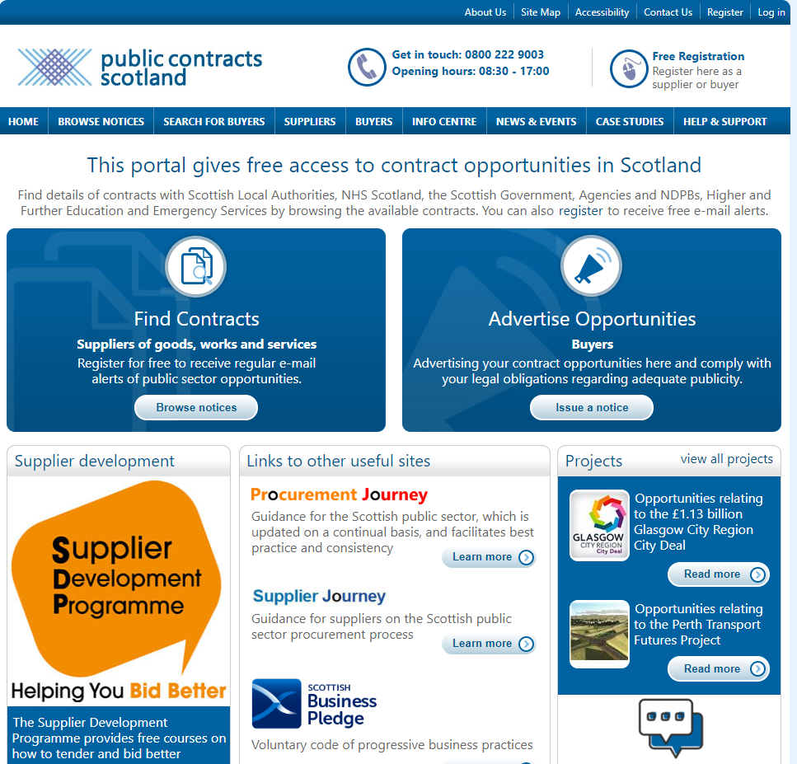
Contract Notices
Published to the market through Government Portal (Public Contracts Scotland)
Sets out minimum standards
Sets our award criteria to be evaluated against
Sets the roadmap for the full procurement process

Slide 30
What does this mean in practice?
Spend of are over £50k is classed as a Regulated procurement.
Mandatory use of electronic communication/ tendering above £50k
Award notices above £50k must be published on Public Contracts Scotland portal
Public bodies must maintain a contracts register for regulated procurements
Notes:
Regulated procurements over £50k – means more transparency is required when the total value of a contract is over £50k. It is manadatory to use electronic tendering procedures and award notices must be published on the PCS portal. They must be added to a contract register.
Difference for RC is award of negotiated contracts and direct calls offs from existing frameworks when spend is over £50k.

Slide 31
What does this mean in practice?(2)
There are new processes to consider using
Supplier self declaration (ESPD)
Suppliers can be excluded due to poor performance
Cannot award on lowest price only (MEAT)
Procurement strategies and annual reports required.
Notes:
We have new processes to consider which are intended to be helpful and these will explored as requirements present themselves. Wher eit is consider a benefit to do so. Will touch onthese later.
Social care and more specifically personal care falls under the new light regime which allows these contracts to be awarded without competition up to £589k
New european single procurement document is a pre evaluation that the supplier will self declare and references or evidence will be requested after evaluation. It is still possible where justifiable to do so to request evidence at the beginning of a process if it would be detrimental to take all through evalaution.
Excluded due to poor performance – this can be applied where robust contract management is in place and there is detail of failure and addressing the failure so not where the performance is considered poor without this detail.
There must be a balance of proce and quality for all contracts.
Procurement startegies must be published with an annual report
(or refresh of the actions and statistics).

Slide 32

Award Notices and Notification
Award Notices:
  Legal obligation
  Published no later than 30 days after award
  Published to the public
  Details successful supplier, contract value etc
Feedback to bidders:
  Legal obligation
  Scores achieved against award criteria
  Reasons for scores
  Successful supplier scores
  Advantages of successful suppliers bid
Notes:
It maybe that there is a valid reason to award with out competition however, mostly (with only a few exemptions) spend above £50k required an award notice to be published on PCS.

Slide 33

Community Benefits
Legislation
  Consideration for Contracts above £4m
  Good practice
  Include in other contracts to contribute to the value achieved by spending the University’s funds.
Notes:
Community Benefits are related to targeted recruitment and training, support and development of supply chains in particular SME’s and are intended to improve the economic, social or environmental wellbeing of the contracting authorities area in a way additional to the main purpose of the contract in which the requirement is included.
The regulations state that contracts above £4m should be considered for CBs.
Community Benefits Strategy is under consideration
An example of Community Benefits in action is the contract for the District Energy Network or more commonly referenced as the CHP (Combined Heat and Power). Through the award of this contract numerous community benefits have been achieved such as the employment of apprentices, paid work placements, undergraduate/ graduate internship, engagement with community groups, inclusion of local SME’s and sponsoring sustainability events.

Slide 34
Setting up Suppliers
Procurement adds supplier to FMS when the contract is awarded.
Suppliers are refused to be added when no contract is in place
Supplier on FMS doesn’t mean there is a contract
Check supplier details are correct (e.g. Ltd, PLC, Group).
Notes:
If a contract has been placed by procurement the team will add the supplier to the system.
The first barrier to adding a supplier is procurement will check if there is a complaint contract in place.
Often staff see a supplier on the system and assume this means there is a contract therefore can buy from this supplier compliantly.
If you have had an SSJ signed off it would be useful to attach this to the new supplier request, this should avoid the need to for extra timescales in establishing if a contract is in place.

Slide 35

No PO No Payment
The University has enforced this policy.
An organisation who receives Public funding has an obligation to pay contractors in 30 days without a PO this may not happen!
All invoices must be sent electronically to finance at fms-supplierinvoices@strath.ac.uk to ensure payment.
Placing a purchase order is a fundamental procedure to adhere to.
Notes:
Ensure all invoices are sent to finance directly by email for payment.
Placing a purchase order allocates the funds to the supplier and is a necessity for accounting and budgeting purposes.

Slide 36
Request For Payment
(RFP)
These are payments requested by cheque or direct payment
They are all recorded and reported
This is bypassing the public funds procedures
Creates risk for the University
Rule that only under £3k will be allowed by sundry payment.

Slide 37


