Slide 1
Sexual Violence & the Law

Slide 2
Recognising Consent
Case Studies

Slide 3
Case Study 1
Jane and Graeme are at house party, they start to kiss and Graeme suggests they go upstairs. They lie on a bed and kiss some more, Graeme tries to take Jane’s underwear off but she pushes his hand away several times, they continue kissing and he tries again, she doesn’t move his hand this time, Graeme starts to have sex with her.
Did Jane give consent?

Slide 4
Case Study 2
Jen and Andrew have been married for two years, one night Andrew initiate’s sex with Jen, she is giggling and kissing him but she says she has a headache and wants to be left alone. Andrew continues to kiss her and touch her, eventually he climbs on top of Jen and has sex with her.
Did Jen consent?

Slide 5
Case Study 3
Craig and Colin have been married for two years, one night Colin initiate’s sex with Craig, he is giggling and kissing him but he says he has a headache and wants to be left alone. Colin continues to kiss Craig and touch him, eventually he climbs on top of Craig and has sex with him.
Did Craig consent?

Slide 6
Case Study 4
Molly has been dating Frank for two years (they are both 21 yrs. old), Frank convinces Molly to film them having sex, Molly agrees as long as it’s kept private. Next day at football Frank shows a couple of his pals the video, he doesn’t send it to them he just shows them on his own phone.
Has Frank broken the law?

Slide 7
What is the definition of Rape?

Slide 8
Definition of Rape
Definition of rape has changed since December 2010:
The Sexual Offences (Scotland) Act 2009
states that rape occurs when a person intentionally or recklessly
penetrates another person’s vagina, anus or mouth with their penis,
where the victim does not consent and the person responsible has no reasonable belief that the victim is giving consent.
In circumstances where penetration is initially consented to but
consent is later withdrawn, the person responsible will have
committed rape.
The victim can be male or female.

Slide 9
Consent Defined
Consent is defined as free agreement. The law is clear that consent can be withdrawn at any time, and that consent to one sexual act does not in itself mean consent to a different act
Consent cannot be given when:
Someone is intoxicated or unconscious as a result of alcohol or drugs
Someone is asleep
The person is mentally disabled
False representation of identity
Consent cannot be coerced

Slide 10
Sharing of Sexual Imagery
The Abusive Behaviour and Sexual Harm (Scotland) Act 2016
Passed in the Scottish Parliament on the 22nd March 2016
Came in to effect April 1st 2017
Non-consensual sharing of sexual images (age 18+)
Threatening to share sexual images
Carries up to 5 years in prison
You do not have to physically share the image or video, simply showing it on your phone or other electronic device to others is enough to break the law
It is always illegal to share sexual images or videos with anyone under the age of 18 years

Slide 11
Myths & Facts
What percentage of victims know their attacker?

Slide 12
Myths & Facts
85 %
Partners
Ex partners
Family members
Friend
Colleague
Other acquaintance

Slide 13
Myths & Facts
In what year did rape in
marriage become illegal in Scotland?

Slide 14
Myths & Facts
1989
And 1991 in England
Before these dates a woman had no legal protection for the crime of rape perpetrated against her by her husband

Slide 15
Myths & Facts
In a survey carried out in February 2008 for the Scottish Government, what percentage of people in Scotland said a woman may be to blame for being raped if she was wearing revealing clothing?

Slide 16
Myths & Facts
27%
This Is Not An Invitation
To Rape Me

Slide 17
Changing Societies Attitudes
How to challenge attitudes?
How to make changes?
How to create a healthier, fairer socoiety?

Slide 18
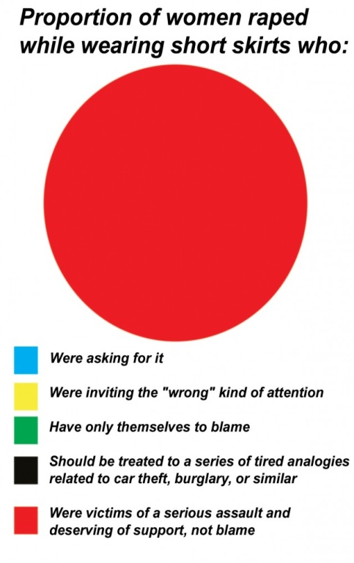
Rape Crisis Scotland Campaigns

Slide 19
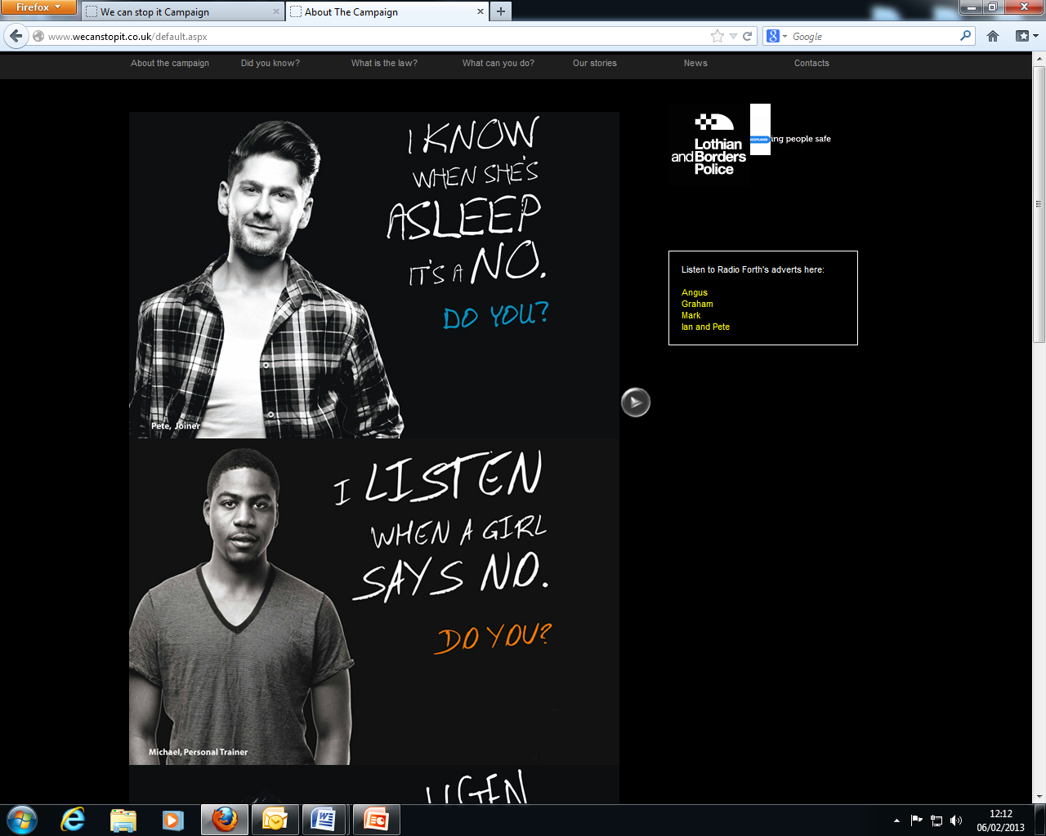
Police Scotland Campaign

Slide 20
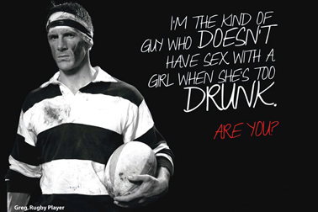
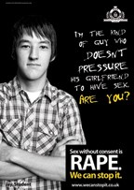
Myths & Facts
www.wecanstopit.co.uk

