Slide 1


Pornography Awareness

Slide 2
Pornography
Different forms of pornography
Erotica – artistic work to stimulate sexual arousal, can include paintings, sculptures, books, music or film. Classed as ‘high art’, differentiating it from commercial pornography
Mainstream – presentation of films where actors engage in sexual acts that are not simulated
Extreme – presentation of films that depict violent, degrading and offensive sexual acts, usually against women for sexual arousal

Slide 3
Mainstream Pornography
Although viewed by some as a form of gender based violence, mainstream pornography is largely accepted as a form of consensual sexual stimulus. However, it has been blamed for the continued sexualisation of society and young people and it’s being used by young people to explore what sex means.
Some young people are using the internet to learn about sex, however often when that question is put in to a search engine this is what appears…

Slide 4
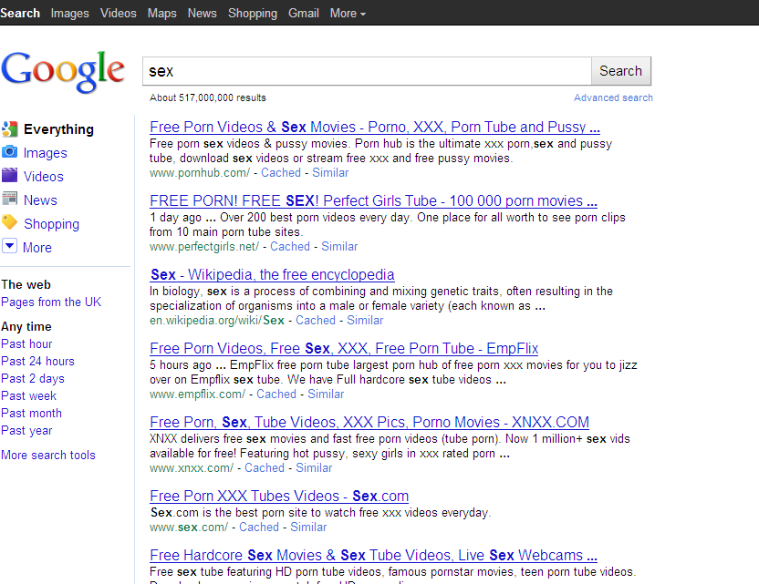

Slide 5
Mainstream Pornography
A recent research report has been undertaken between 2013-2015 by a team of researchers from the Universities of Bristol and Central Lancashire led by NSPCC Senior Research Fellow, Dr Christine Barter. This research found that 39% of boys in England aged 14-17 regularly watched pornography (STIR, 2015)
We know that boys as young as 11 years old are accessing pornography to find out about sex and girls, if we click on the first link from the Google search this is what they are told to expect.....

Slide 6

Mainstream Pornography

Slide 7
Extreme Pornography
However, increasingly more and more men and boys are accessing extreme pornography
Section 42 of the Criminal Justice and Licensing (Scotland) Act 2010 provides for a new offence criminalising the possession of extreme pornographic material. It came into force on 28 March 2011. The Scottish offence covers all images of rape or other non-consensual penetrative sexual activity

Slide 8

Extreme Pornography
One of the highest grossing genres of pornography on the internet is violent porn. Billions of pounds each year is spent by ordinary people (usually men/boys) to access pornography, increasingly the sites accessed depict forced and extremely violent sexual acts. One of the most ‘popular sites’ featuring and targeting young men is Rape Tube………….

Slide 9

Extreme Pornography

Slide 10

Extreme Pornography

Slide 11
Group Discussion
Now we have an understanding of what pornography is and how widely it is used we are going to have a discussion about how it may effect people who watch it, looking at the following:
Physical Health
Body Image
Unrealistic Perceptions of Relationships

Slide 12
Physical Health
In small groups discuss how you think a persons physical health might be effected by watching pornography.....

Slide 13
Physical Health
Reduction in sexual stimulation
Reduction in sexual satisfaction
Difficulty in processing sexual content
Pressure to engage in ‘porn like sex’ to reach climax
Can effect the ability to form ‘normal’ sexual relationships
Source: Analysis by Bazian
Edited by NHS Choices

Slide 14
Body Image
In small groups discuss how you think a persons
confidence and self-esteem might be effected by watching pornography.....

Slide 15
Body Image
60 % of teenagers surveyed said viewing porn effected their confidence & self-esteem
45% of young women viewing porn said they felt they wanted to have plastic surgery
27% of young men said they were concerned about the shape and size of their penis
60% of young people admitted watching porn gave them false ideas about sex
45% of boys watching porn said they are now anxious about their ‘own performance’
All the above effecting the mental health of the porn user
Source: Survey for the Channel 4 Sex Education vs. Pornography programme

Slide 16
Unrealistic Perceptions of Relationships
In small groups discuss how you think a persons
idea of what a relationship should be like might be influenced by watching pornography.....

Slide 17
Unrealistic Perceptions of Relationships
Applying pressure on a partner to perform like they do in pornography
A desire to act out degrading sexual experiences on their partner
Reduces intimacy and tenderness
Distortion of ‘real world’ relationships
Diminished enjoyment of ‘normal sexual relationships’
Source: Arkansas psychologist Ana Bridges who surveyed 487 male college students

