Slide 1
Domestic abuse & risk identification
Strathclyde University
March 2018
Lucy McDonald

Slide 2
What we do
2000+
DA advocates trained
300+
Maracs supported
43,000
Cases in our research database
50
Services using our Insights data tool
49
Services with Leading Lights accreditation
Notes:
In Scotland this looks like over 200 Idaas trained, 28 Maracs operating and being supported by MDP, 5 Insights pilot services, 2 services with LL (3rd one going through it). We’ve done lots of bespoke training on risk and Dash with NHS, Police Scotland, COPFS, local authorities and services.

Slide 3
Diversity statement
It is the responsibility of the entire group to ensure that:
This training actively contributes to developing a diverse learning environment which leads to the delivery of appropriate services.
The particular needs of each person are recognised and respected whether they be learners or clients.

Slide 4
Scottish Government definition
Domestic abuse (as gender-based abuse) can be perpetrated by partners or ex-partners and can include physical abuse (assault and physical attack involving a range of behaviour), sexual abuse (acts which degrade and humiliate women and are perpetrated against their will, including rape) and mental and emotional abuse (such as threats, verbal abuse, racial abuse, withholding money and other types of controlling behaviour such as isolation from family and friends).
Scottish Executive (2003)
Notes:
Well established definition, recognises the gender bias. Key difference with E&W is that it is partner/ex-partner only

Slide 5
Police Scotland/COPFS definition
Any form of physical, verbal, sexual, psychological or financial abuse which might amount to criminal conduct and which takes place within the context of a relationship. The relationship will be between partners (married, cohabiting, civil partnership or otherwise) or ex-partners. The abuse can be committed in the home or elsewhere including online. It is acknowledged that domestic abuse as a form of gender based violence is predominately perpetrated by men against women. This definition also acknowledges and includes abuse of male victims by
female perpetrators and includes abuse of lesbian, gay, bisexual, transgender and intersex (LGBTI) people within relationships
Notes:
Updated in 2017 to acknowledge gender bias. The DA Bill (anticipated end 2018) will bring new legislation to prosecute wider range of offences – coercive control.

Slide 6
Domestic Abuse Data – criminal justice
58,408 domestic incidents recorded by Police Scotland in 2016-17
Domestic incidents account for 24% of all violent crime in Scotland, and accounts for 20% of police business, with police attending a domestic incident every 9 minutes.

Slide 7
SafeLives Research
More than 100,000 people in the UK are at high/imminent risk of being murdered or seriously injured as a result of domestic abuse - estimated to be around 9,360 in Scotland (SafeLives, 2015, 2017).
Women are much more likely than men to be the victims of high risk or severe domestic abuse: 95% of those going to Marac or accessing an advocacy service are women (SafeLives, 2014)
On average high-risk victims live with domestic abuse for 2.6 years in England and Wales before getting help. In Scotland this is 4 years (SafeLives, 2015, 2017)
130,000 children live in homes where there is high-risk domestic abuse in UK and in Scotland we estimate this around 12,480 (SafeLives, 2015, 2017)
62% of children living with domestic abuse are directly harmed by the perpetrator of the abuse, in addition to the harm caused by witnessing the abuse of others (Caada, 2014)

Slide 8
Statistics on Young People
17% young women experienced abuse in their relationship (NHS Scotland 2005). UK - 25% girls experience physical abuse, 75% experience emotional abuse (NSPCC 2009)
Whole Lives – less than 1% accessing services are under 18
SafeLives data collection survey (2012):
76% were experiencing physical abuse
53% were experiencing harassment
22% were experiencing sexual abuse
Impact (SafeLives 2012)
27% had attended A&E for injuries
27% had self-harmed
21% had threatened/attempted suicide
Attitudes
1/3 young men and 1/6 young women felt use of violence in a relationship was acceptable under certain circumstances (NHS Scotland 2005).
Notes:
Whole Lives showed us that very few under 18 year olds are accessing specialist (Idaa) services in Scotland

Slide 9
Biderman

Slide 10
Risk identification is...
“The process of looking at what the possible outcomes might be from any identified hazard or threat, using a combination of known information and informed judgement”.
(Regan et al 2007)

Slide 11
Methods to identify risk:
Visible Risk
predicting from knowledge.
based on risk factors.
uses a tool and evidence based approach.
informs professional judgement.
Professional Judgement
uses knowledge & professional experience.
can be based on victims perception.
utilises observation and assessment.
Escalation
in severity and frequency
Notes:
Visible Risk Likelihood of Harm-
PJ - Assess Dangerousness-need combination of the 2
Escalation
Explain how DASH developed and some of different researches

Slide 12
Visible risk factors…
Child contact
Financial problems
Perpetrator threatens suicide
Perpetrator problems with drugs, alcohol and mental health
Pregnancy
Historical patterns of behaviour
Aggravating factors
Nature of the abuse
Victim’s perception of risk
Specific factors associated with an incident
Criminal history
History of hurting others
Previous broken bail, breach of order
Separation
Use of Weapons
Threats to kill
Sexual abuse
Jealous and controlling behaviour
Isolation
Stalking
Abuse getting worse and happening more often
Strangulation
Involvement of others
Fear in relation to self and others
Fears for or threats to pet

Slide 13
Professional judgement considerations…
Recognising minimisation or denial
Understanding how diversity can impact on disclosure e.g. LGBT clients, issues related to honour based violence, disability, etc.
Identifying escalation in terms of frequency and severity
Recognising unusually deviant, concerning or more severe abusive behaviour

Slide 14
Power and Control wheels
MARAC Toolkit
Aide Memoire
Enabling Environment
Asking sensitively
Checklist Completed
Domestic Abuse Identified
Local policies & procedures around domestic abuse
Professional Judgment and Escalation
9 ticks or less
10 – 13 ticks
14 ticks or more
Marac
Idaa and other DA project supporting Marac Cases
Statutory Responsibilities
Local DA Services Safety Information National Helplines (0800 027 1234)
Specialist & Universal Services
Idaa service /DA Service
Plus Helplines
Specialist Services

Slide 15
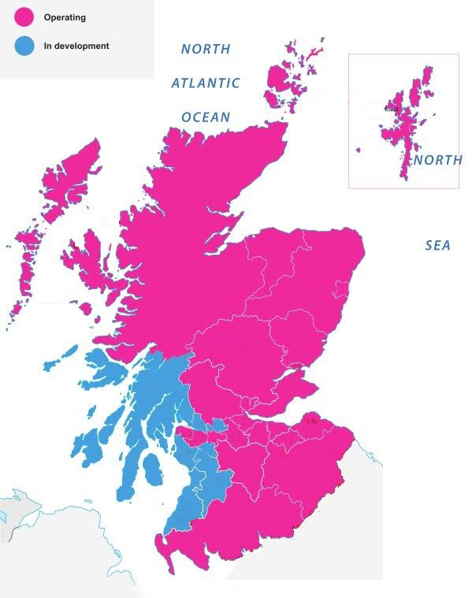
Scottish Maracs
29 Maracs operating per month

Slide 16
Individual safety & support planning…
Risk led
Individualised
Empowering
Collaborative process
Identifying sources of support (professional and personal)
Increasing resilience
Prepares for ‘worse case’ scenarios
S.M.A.R.T. actions

Slide 17
Information Sharing
Before gathering detailed information from a client about domestic abuse you must be clear about your policy on how that information would be recorded and how it might be shared.
We need to have consent to share information about a client unless we have legal authority to disclose without consent
Refer to your own policy and local guidance

Slide 18
Legislation – do you have legal authority to disclose information?
Data Protection Act 1998 (Schedules 2 and 3)
To protect vital interests of the data subject; serious harm or matter of life and death. For the administration of justice (usually bringing perpetrators to justice) Prevention and detection of crime and/ or the apprehension or prosecution of offenders. For the exercise of functions conferred on any person by or under an enactment (Police/Social Work)
Adult Support & Protection Act 2007
Local Govt (Scotland) Act 2003
Children and Young Person’s (Scotland) Act 2014
Getting it Right for Every Child (GIRFEC)
“If there is any doubt about the safety or wellbeing of a child, the Data Protection Act should not be viewed as a barrier to proportionate sharing.”

Slide 19
Sharing Without Consent – Balance and Consider
Duty of confidentiality
Legal duty and supporting legislation
Respective risks to those affected
Need of other agencies to be informed
Proportionate response
Record your actions
When sharing information, it is essential that we make ‘defensible’ not defensive decisions
We need to be clear from the outset

Slide 20
Questions & contact details
Lucy McDonald Training Development Officer
Lucy.Mcdonald@SafeLives.org.uk 07785 611 099
SafeLives General
info@safelives.org.uk.
Bristol Office: 0117 403 3220
www.safelives.org.uk

